Slide 1



Effect of Flue Gas on Algae Growth
By Esteban Jimenez
Mentored by Dr. Kimberly Ogden
Department of Chemical and Environmental Engineering
Saturday, April 16th, 2016
University of Arizona

Slide 2
Background - Algae
Beneficial and useful
Food for both humans and animals
Water treatment since species can filter impurities out
My focus is on energy
How?
More efficient to grow than trees or other plants
Biomass can be turned into biofuel (ethanol and diesel)
Does not increase CO₂ emissions and reduces GHG

Slide 3
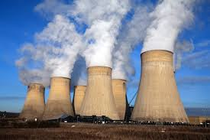
Flue Gas
What is it?
Exhaust gas from power plants after fuel combustion
High CO₂ concentration (most ~20%)
UA Central Heating and Refrigeration Plant – 5%
Why is it important for us?
CO₂ sequestration from algae not efficient with air (~1%)
Fuel made from this algae is greener than without flue gas
Actually decreases CO₂ emissions since it reduces amount released from factories
(Cuellar-Bermudez & Van Den Hende)

Slide 4

Flue Gas - continued
Composition
Mainly N₂ and CO₂
Can also contain O_{2,} H₂O, NO_{x,} SO_{x,} CO, C_{x}H_{y} and other heavy metals
Depends on composition of original fuel (coal vs. natural gas) as well as the reactor efficiency
Why we care
Different algae have different tolerances to these compounds
O₂ and SO_{x} can be toxic, must be regulated
(Van Den Hende)

Slide 5
Objectives
Determine the biochemical effect that water saturated with flue gas had on algae growth
Growth monitoring through Optical Density (OD)
Analysis of metabolic products such as lipid content
Cultivating microalgae waste source by combining process to make it suitable – carbon dioxide fixation by microalgae using flue gas from UA power plant
5% CO₂

Slide 6
Experiment Set up
Chlorella
Control
1 Hour
13 Hours
24 Hours
Notes:
JM

Slide 7
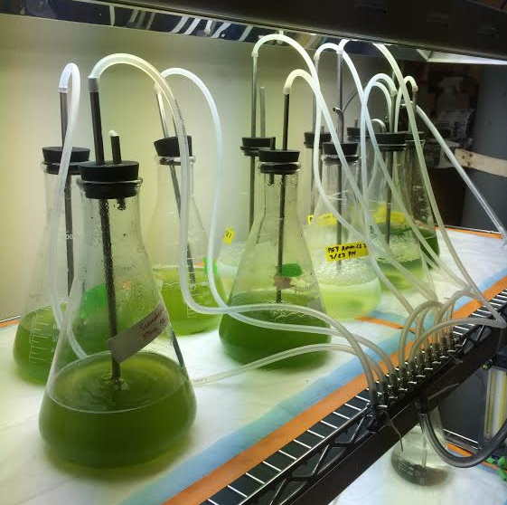

Slide 8
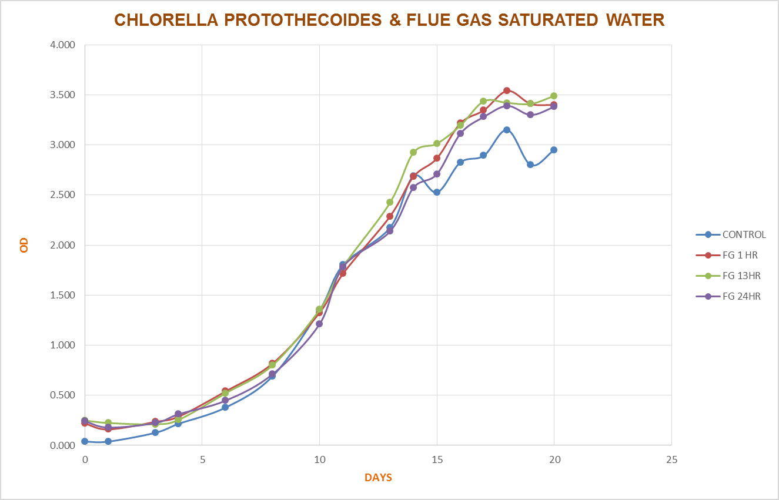

Slide 9
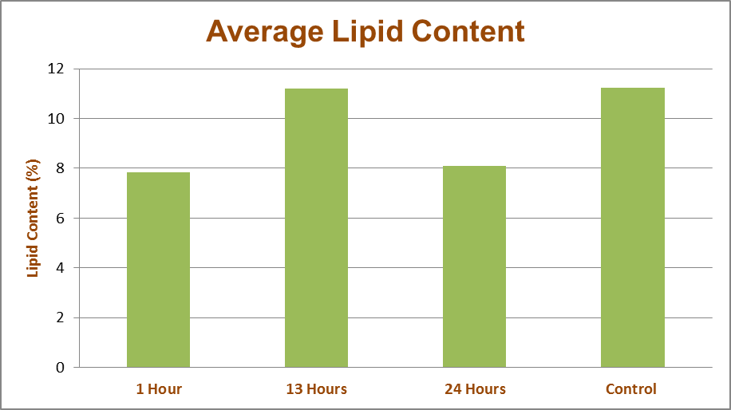

Slide 10
Conclusion and Moving Forward
Results are promising
Flue gas did not have significant impact on growth, but did not decrease it either
Time of exposure to flue gas does not appear to matter
This means exposure time is irrelevant, and we can use CO₂ to control the pH in outside setting
We want bigger
To be efficient, this has to be able to work on industrial setting
Much closer to what would be full-scale production of algae

Slide 11
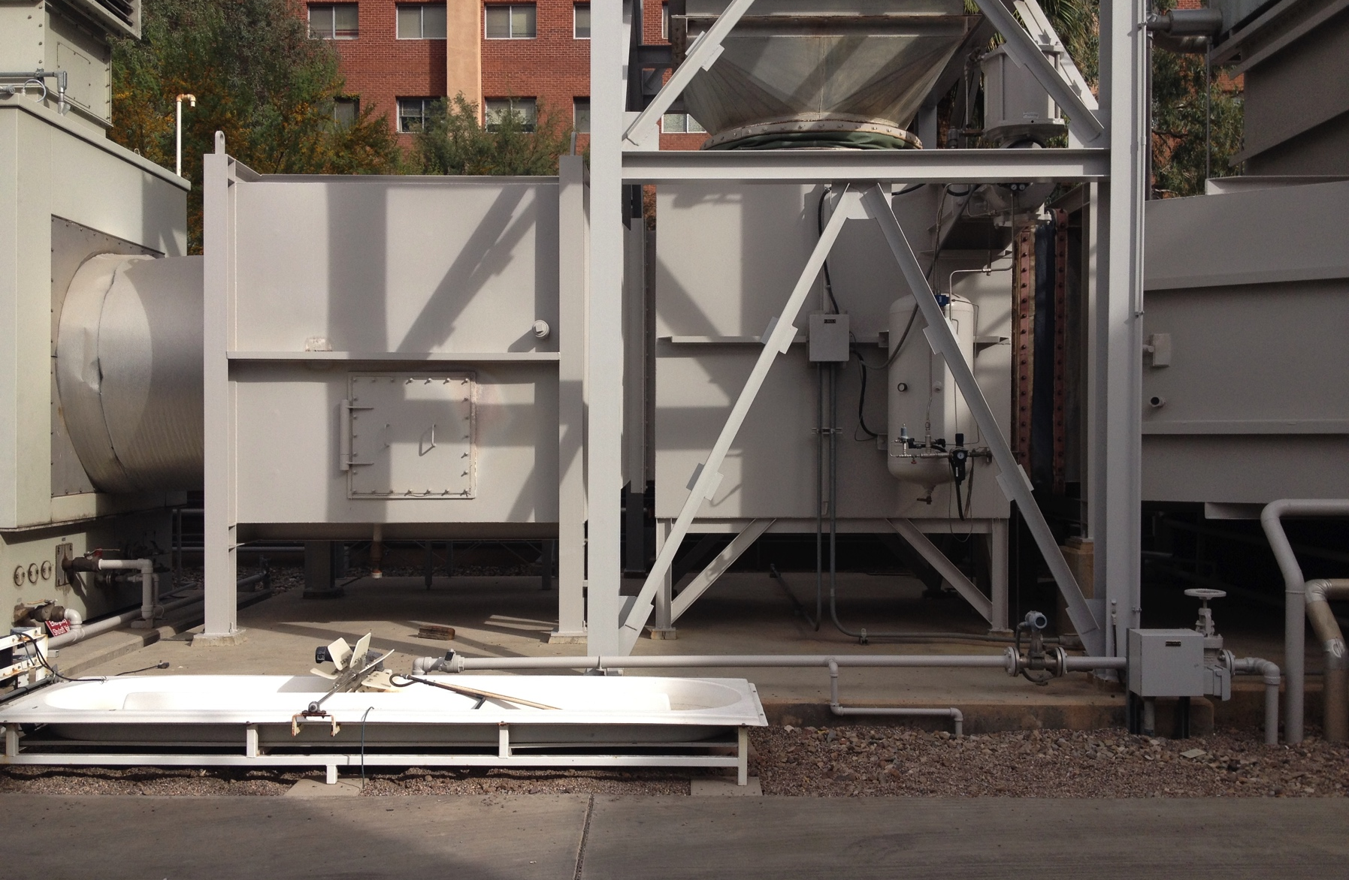
Power plant picture

Slide 12
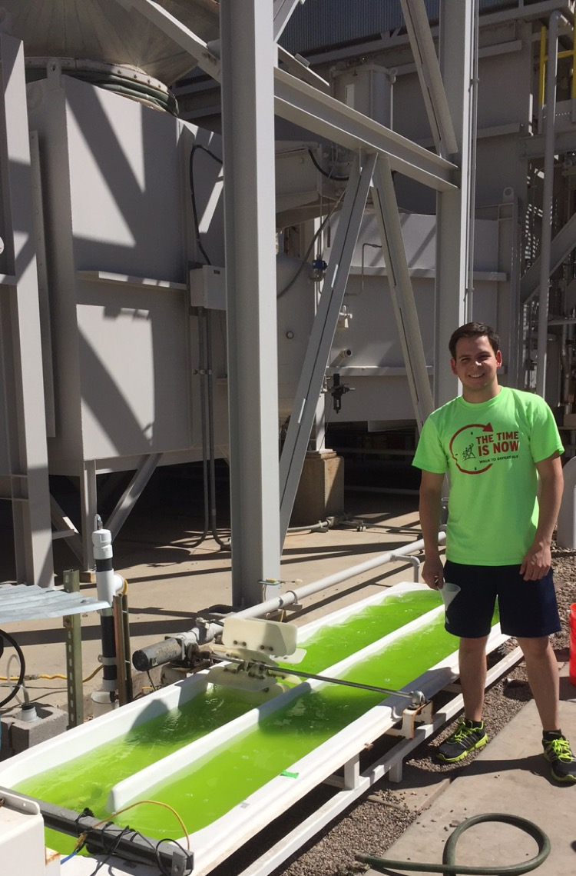
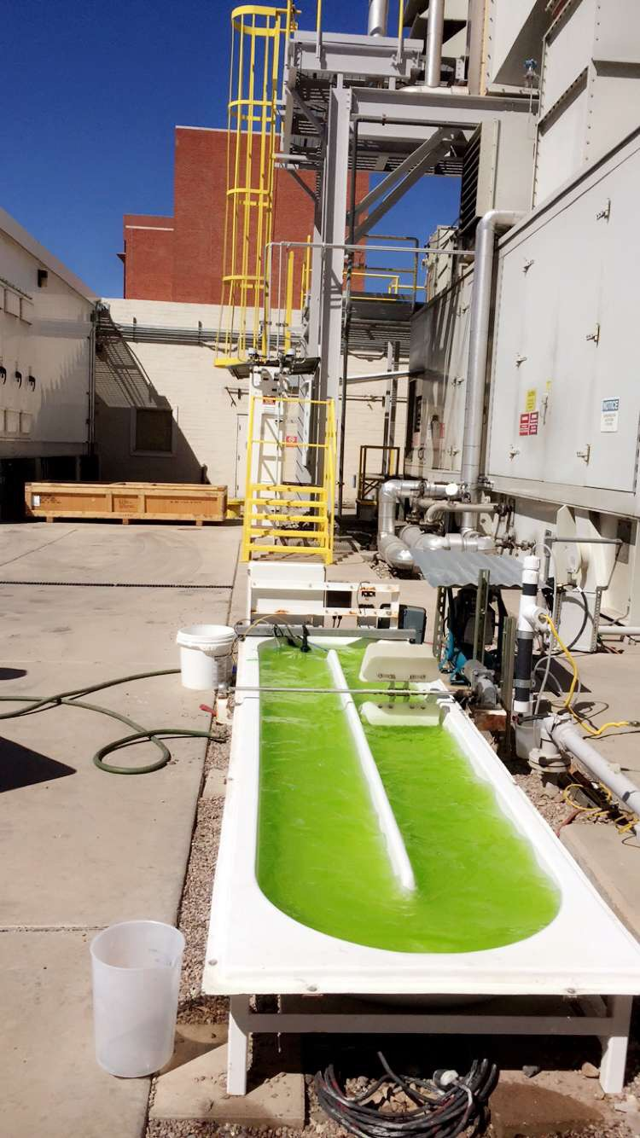
Power Plant

Slide 13
Acknowledgements and Thanks
Margarita Acedo
Juan Sandoval
Dr. Kim Ogden
NASA Space Grant
University of Arizona
Algae

Slide 14
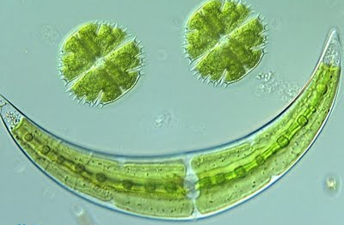
Thank you!

